Slide 1

DIGISOLE
Shoe Charm, Protected from Harm!

Slide 2
TABLE OF CONTENTS
01
02
Problem
Solution
03
Future Plans
Losing your valuable footwear in the Delhi Bangla Sahib Gurudwara is nothing new for Sikh residents of Delhi.
Visitors can choose which locker to keep their treasured slippers and other footwear in by using an interface we created for this purpose.
Make a network that connects all of India's bangla sahibs so that people can reserve lockers wherever they go.

Slide 3
PROBLEM
Most of us have undoubtedly seen or heard of a shoe being stolen in bangla sahib in our neighbourhood.
The system's present fatal fault is the failure to maintain an appropriate system for shoe security, particularly in India. Think about how many of the stolen shoes might have been avoided if a suitable system had been created.
This presentation offers a potential fix and a few examples that can be utilised to get beyond this significant problem.

Slide 4
SOLUTION
Visitors can use an interface we designed for the security of footwear to select which locker to store their valued slippers and other footwear in.

Slide 5
ADVANTAGES
Enhanced security
Improved convenience
Hygiene and cleanliness
Analytics and insights
Conventional shoe storage practises could entail personnel supervision or leaving shoes unattended. Visitors can individually lock their shoes using a digital locker system, improving security and lowering the possibility of loss or theft.
A digital shoe locker system makes it possible for guests to safely keep their shoes while they explore the gurdwara grounds. This makes it unnecessary for visitors to carry shoes the entire time, making their experience more comfortable.
Visitors can maintain a clean and sanitary environment at the gurdwara by using the shoe lockers. In order to keep the area clean for everyone, shoes must be removed at the door. This stops dirt, dust, and other contaminants from being taken within.
Digital systems can record information on visitor patterns, peak hours, and locker usage. The management of the gurdwara can use these insights to streamline processes, allocate funds wisely, and develop future improvement plans.

Slide 6
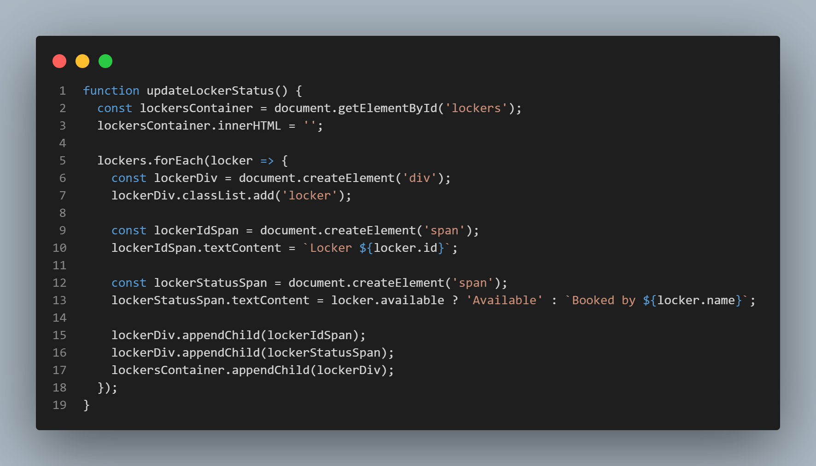
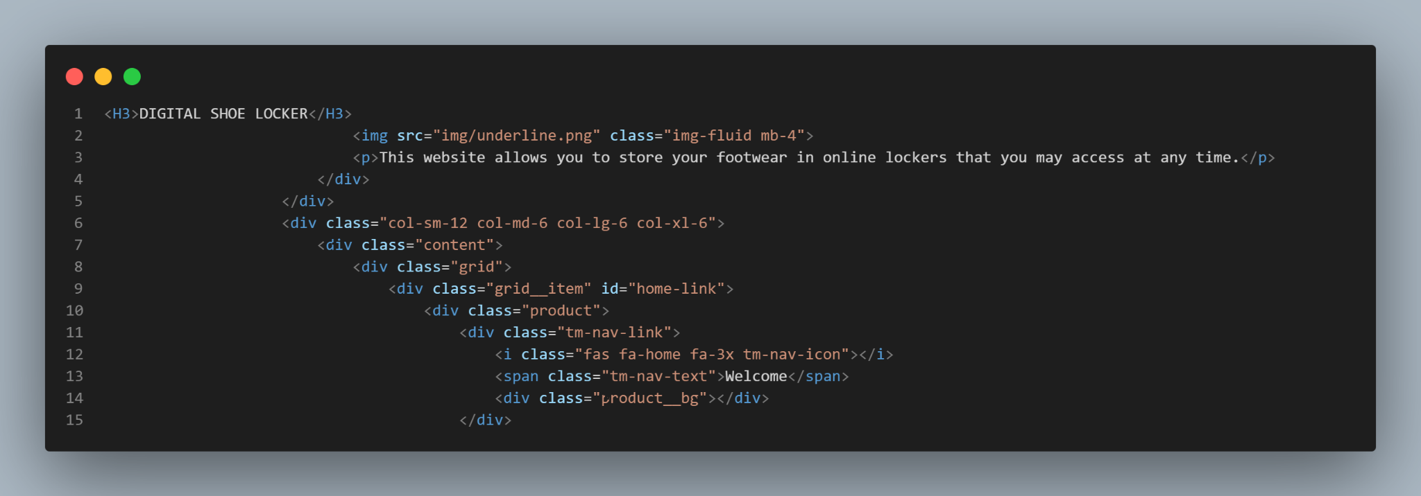
CODE
JAVASCRIPT
HTML

Slide 7

DEMO

Slide 8


Our team
Diwanshu Gupta
Mankirat Singh

Slide 9
Thanks!
Do you have any questions?
helpdesk.digisole@gmail.com

